Slide 1
Inheritance
Inheritance allows a software developer to derive a new class from an existing one
The existing class is called the parent class, or superclass, or base class
The derived class is called the child class or subclass
As the name implies, the child inherits characteristics of the parent
That is, the child class inherits the methods and data defined by the parent class
8-<number>

Slide 2
Inheritance
Inheritance relationships are shown in a UML class diagram using a solid arrow with an unfilled triangular arrowhead pointing to the parent class
Vehicle
Car
Proper inheritance creates an is-a relationship, meaning the child is a more specific version of the parent
8-<number>

Slide 3
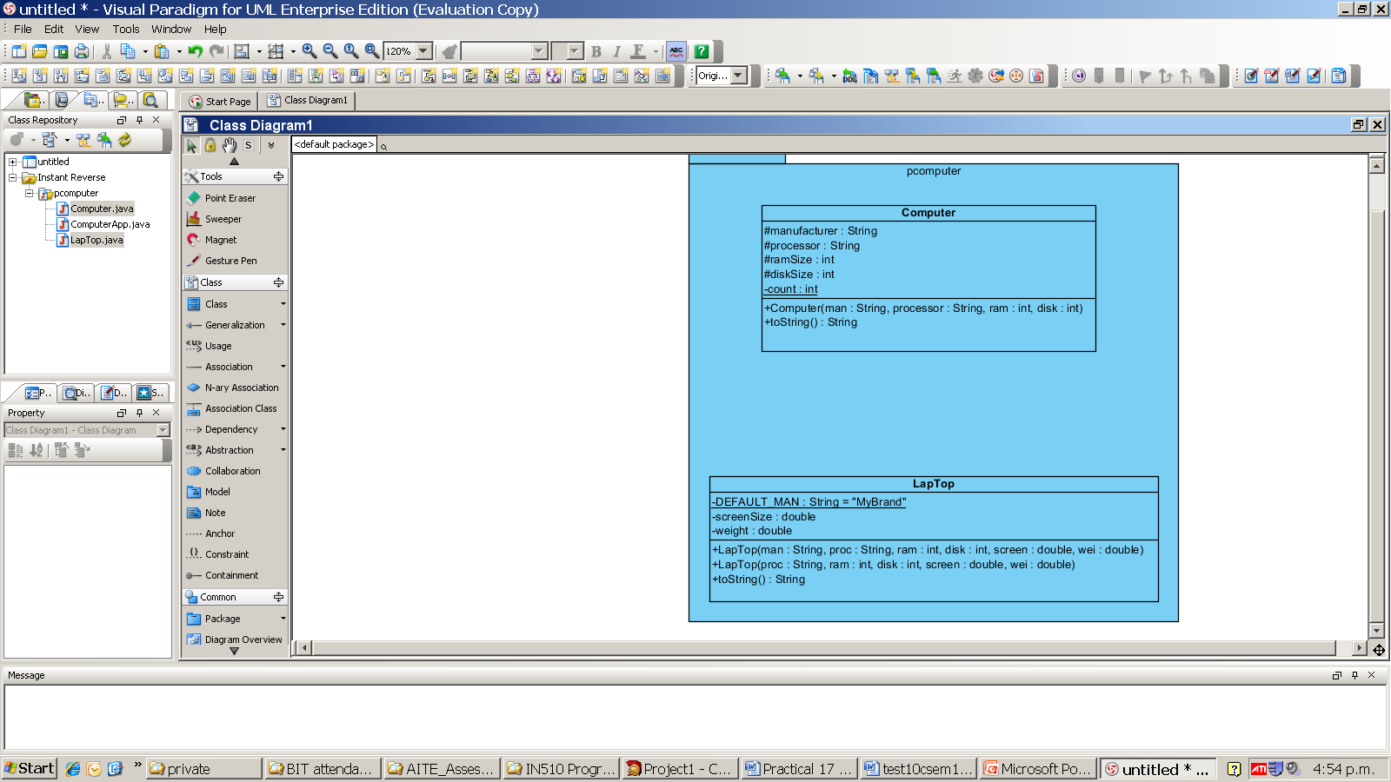
Static methods and fields are indicated by underlining
8-<number>

Slide 4
Inheritance
A programmer can tailor a derived class as needed by adding new variables or methods, or by modifying the inherited ones
Software reuse is a fundamental benefit of inheritance
By using existing software components to create new ones, we capitalize on all the effort that went into the design, implementation, and testing of the existing software
8-<number>

Slide 5
Deriving Subclasses
In Java, we use the reserved word extends to establish an inheritance relationship
public class Car extends Vehicle
{
}
8-<number>

Slide 6
The protected Modifier
Visibility modifiers affect the way that class members can be used in a child class
Variables and methods declared with private visibility cannot be referenced by name in a child class
They can be referenced in the child class if they are declared with public visibility - but public variables violate the principle of encapsulation
There is a third visibility modifier that helps in inheritance situations: protected
8-<number>

Slide 7
The protected Modifier
The protected modifier allows a child class to reference a variable or method directly in the child class
It provides more encapsulation than public visibility, but is not as tightly encapsulated as private visibility
A protected variable is visible to any class in the same package as the parent class
Protected variables and methods can be shown with a # symbol preceding them in UML diagrams
8-<number>

Slide 8
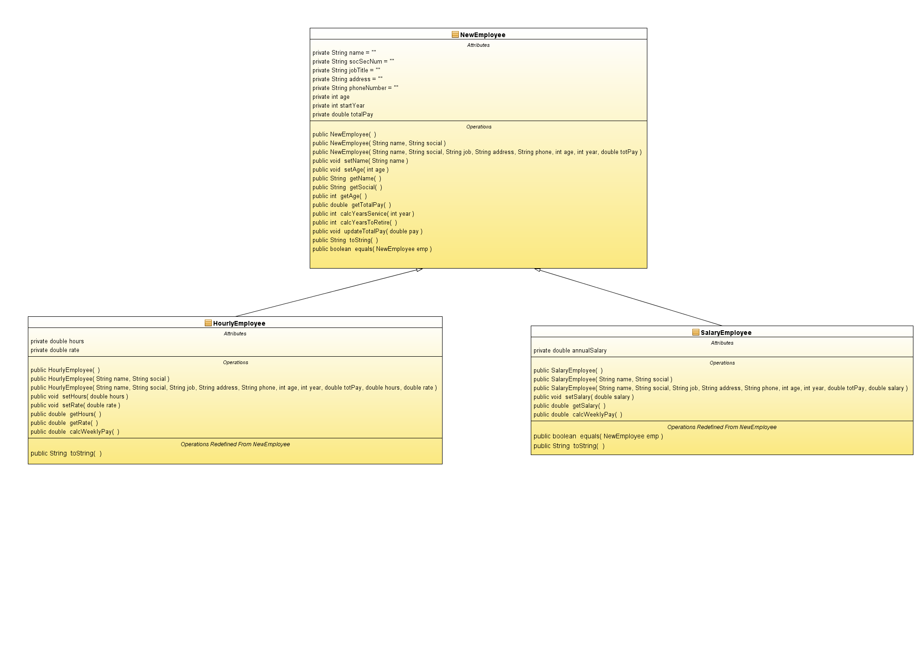
Class Diagram for Employee
Properties should be protected not private
8-<number>

Slide 9
The super Reference
Constructors are not inherited, even though they have public visibility
Yet we often want to use the parent's constructor to set up the "parent's part" of the object
The super reference can be used to refer to the parent class, and often is used to invoke the parent's constructor
  code example
8-<number>

Slide 10
super
public class HourlyEmployee extends NewEmployee {
// data fields could be protected
private double hours;
private double rate;
// constructors
public HourlyEmployee(String name, String social) {
super(name, social); }
public HourlyEmployee(String name, String social, String job, String address, String phone, int age, int year, double totPay, double hours, double rate) {
super(name, social, job, address, phone, age, year, totPay);
this.hours = hours;
this.rate = rate; }
public String toString() {
return super.toString() + "\nweekly hours: " + hours +", hourly rate $" + rate;
}
8-<number>

Slide 11
The super Reference
A child’s constructor is responsible for calling the parent’s constructor
The first line of a child’s constructor should use the super reference to call the parent’s constructor
The super reference can also be used to reference other variables and methods defined in the parent’s class
8-<number>

Slide 12
Multiple Inheritance
Java supports single inheritance, meaning that a derived class can have only one parent class
Multiple inheritance allows a class to be derived from two or more classes, inheriting the members of all parents
Collisions, such as the same variable name in two parents, have to be resolved
Java does not support multiple inheritance
In most cases, the use of interfaces gives us aspects of multiple inheritance without the overhead
8-<number>

Slide 13
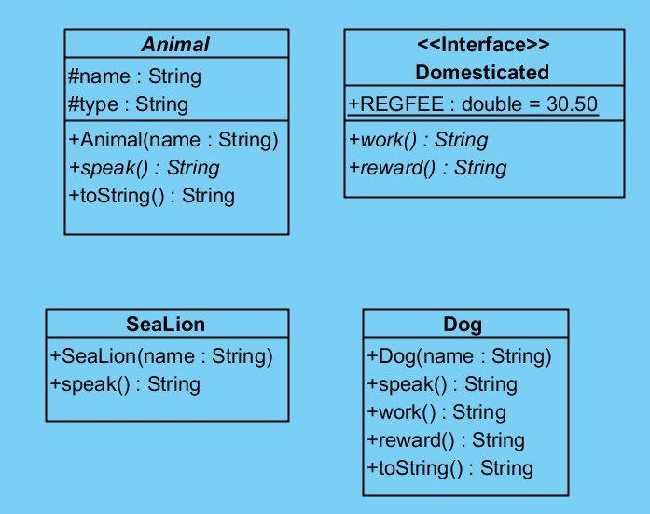
abstract
abstract
8-<number>

Slide 14
Interfaces
An Interface looks like a class except all it’s methods are public and abstract
Any data must be public static final (like a constant)
public interface Domesticated
8-<number>

Slide 15
Overriding Methods
A child class can override the definition of an inherited method in favor of its own
The new method must have the same signature as the parent's method, but can have a different body
The type of the object executing the method determines which version of the method is invoked
  If the object is of type child and the child and the parent have the same method signature the child’s method will run
8-<number>

Slide 16
Overriding
A method in the parent class can be invoked explicitly using the super reference
If a method is declared with the final modifier, it cannot be overridden
The concept of overriding can be applied to data and is called shadowing variables
Shadowing variables should be avoided because it tends to cause unnecessarily confusing code
8-<number>

Slide 17
Overloading vs. Overriding
Overloading deals with multiple methods with the same name in the same class, but with different signatures
Overriding deals with two methods, one in a parent class and one in a child class, that have the same signature
Overloading lets you define a similar operation in different ways for different parameters
Overriding lets you define a similar operation in different ways for different object types
8-<number>

Slide 18
The Object Class
A class called Object is defined in the java.lang package of the Java standard class library
All classes are derived from the Object class
If a class is not explicitly defined to be the child of an existing class, it is assumed to be the child of the Object class
Therefore, the Object class is the ultimate root of all class hierarchies
8-<number>

Slide 19
The Object Class
The Object class contains a few useful methods, which are inherited by all classes
For example, the toString method is defined in the Object class
Every time we define the toString method, we are actually overriding an inherited definition
The toString method in the Object class is defined to return a string that contains the name of the object’s class along with some other information
8-<number>

Slide 20
The Object Class
The equals method of the Object class returns true if two references are aliases
We can override equals in any class to define equality in some more appropriate way
As we've seen, the String class defines the equals method to return true if two String objects contain the same characters
The designers of the String class have overridden the equals method inherited from Object in favor of a more useful version
8-<number>

Slide 21
Abstract Classes
An abstract class is a placeholder in a class hierarchy that represents a generic concept
An abstract class cannot be instantiated
We use the modifier abstract on the class header to declare a class as abstract:
public abstract class Product
{
// contents
}
8-<number>

Slide 22
Abstract Classes
An abstract class often contains abstract methods with no definitions (like an interface)
Unlike an interface, the abstract modifier must be applied to each abstract method
Also, an abstract class typically contains non-abstract methods with full definitions
A class declared as abstract does not have to contain abstract methods -- simply declaring it as abstract makes it so
8-<number>

Slide 23
Code snippets
Read the rest after exercises
8-<number>

Slide 24
Abstract Classes
The child of an abstract class must override the abstract methods of the parent, or it too will be considered abstract
An abstract method cannot be defined as final or static
The use of abstract classes is an important element of software design – it allows us to establish common elements in a hierarchy that are too generic to instantiate
8-<number>

Slide 25
Interface Hierarchies
Inheritance can be applied to interfaces as well as classes
That is, one interface can be derived from another interface
The child interface inherits all abstract methods of the parent
A class implementing the child interface must define all methods from both the ancestor and child interfaces
Note that class hierarchies and interface hierarchies are distinct (they do not overlap)
8-<number>

Slide 26
Visibility Revisited
It's important to understand one subtle issue related to inheritance and visibility
All variables and methods of a parent class, even private members, are inherited by its children
As we've mentioned, private members cannot be referenced by name in the child class
However, private members inherited by child classes exist and can be referenced indirectly
8-<number>

Slide 27
Visibility Revisited
Because the parent can refer to the private member, the child can reference it indirectly using its parent's methods
The super reference can be used to refer to the parent class, even if no object of the parent exists
8-<number>

Slide 28
Designing for Inheritance
As we've discussed, taking the time to create a good software design reaps long-term benefits
Inheritance issues are an important part of an object-oriented design
Properly designed inheritance relationships can contribute greatly to the elegance, maintainabilty, and reuse of the software
Let's summarize some of the issues regarding inheritance that relate to a good software design
8-<number>

Slide 29
Inheritance Design Issues
Every derivation should be an is-a relationship
Think about the potential future of a class hierarchy, and design classes to be reusable and flexible
Find common characteristics of classes and push them as high in the class hierarchy as appropriate
Override methods as appropriate to tailor or change the functionality of a child
Add new variables to children, but don't redefine (shadow) inherited variables
8-<number>

Slide 30
Inheritance Design Issues
Allow each class to manage its own data; use the super reference to invoke the parent's constructor to set up its data
Even if there are no current uses for them, override general methods such as toString and equals with appropriate definitions
Use abstract classes to represent general concepts that lower classes have in common
Use visibility modifiers carefully to provide needed access without violating encapsulation
8-<number>

Slide 31
Restricting Inheritance
The final modifier can be used to curtail inheritance
If the final modifier is applied to a method, then that method cannot be overridden in any descendent classes
If the final modifier is applied to an entire class, then that class cannot be used to derive any children at all
  Thus, an abstract class cannot be declared as final
These are key design decisions, establishing that a method or class should be used as is
8-<number>

